Slide 1
Emmanuel Levinas
7 May 2020
GENTRAIN
MONTEREY PENINSULA COLLEGE
STEPHANIE SPOTO

Slide 2
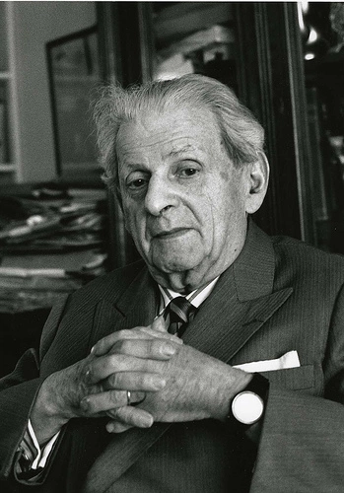
Emmanual Levinas (1906-1995)
Lithuanian-born French philosopher of Jewish ancestry
Respected for his philosophies relating to existentialism, Jewish theology, ethics and phenomenology.
In 1928 went to the University of Freiburg and studied phenomenology under Edmund Husserl → there met and was impressed by Martin Heidegger
Became a naturalized French citizen in 1939, and joined the war efforts against Germany as a translator
In 1940 his unit was surrounded and he was taken as a prisoner of war, where he stayed in a special unit for Jewish prisoners until the war ended
There he began some of his important work, and his notebooks became his Existence and Existents (1947) and Time and the Other (1948).

Slide 3
Major works
Two most important book length works:
Totality and Infinity (1961): explores the concept of the Other and the face-to-face encounter and access to infinity
Otherwise than Being, or Beyond Essence (1974): here he explores ethics as a relationality rather than just a response to the face of the Other

Slide 4
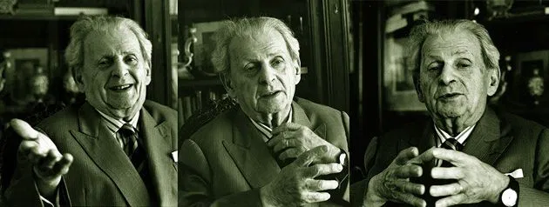
Ethics as First Philosophy
“Ethics as first philosophy” is a phrase most commonly identified with Levinas
Important essay of this title
Ethics as first philosophy → the idea that ethics is the foundational relation upon which all philosophical inquiry is constructed
usually, ‘Western’ philosophy imagines metaphysics or epistemology as the first philosophy
Levinas: all metaphysical or epistemological positions are dependent upon a system of ethical relations which precedes metaphysical or epistemological exploration

Slide 5
The Crisis of European Ethics
Jeffrey M. Murray: two major turning points in the crisis of European ethics:
Nietzsche’s declaration of the death of God and
the Nazi program of racial purity and genocide.
Heidegger: claims that Nietzsche’s declaration that “God is Dead” relates not just to the demise of a divine figure, but to “the suprasensory world in general. God is the name for the realm of Ideas and ideas.”
Levinas: Heidegger wrongly privileges ontology over metaphysics
Chantal Bax: Heidegger creates a “suffocating account of being without room for what is otherwise.”
Chantal Bax
Jeffrey M. Murray

Slide 6
Totality and Western philosophy
The visage of being that shows itself in war is fixed in the concept of totality, which dominates Western philosophy. Individuals are reduced to being bearers of forces that command them unbeknown to themselves. The meaning of individuals (invisible outside of this totality) is derived from the totality. The unicity of each present is incessantly sacrificed to a future appealed to bring forth its objective being. (Levinas, Totality and Infinity)
Here Levinas identifies totality as inherent in the Occident’s conception of ontology as fundamental and as reducing individuals, the self and the other, into a totality that has its origins as far back as Aristotle and which led to the ethical horrors of German fascism.
In his essay, “Liberté de parole,” he claims that “political totalitarianism rests on ontological totalitarianism.”

Slide 7
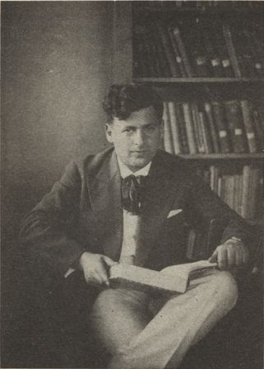
Categorization
Categorization and knowledge is the “embodiment of seizure” → reduces the other to the same:
“But in knowledge there also appears the notion of an…activity or of a …will—a way of doing something which consists…of thinking through knowing, of seizing something and making it one’s own, …an activity which appropriates and grasps the otherness of the known…Knowledge as perception, concept, comprehension, refers back to an act of grasping. The metaphor should be taken literally: even before any technical application of knowledge, it expresses the principle rather than the result of the future technological and industrial order…The immanence of the known to the act of knowing is already the embodiment of seizure” (Levinas, “Ethics as First Philosophy”)

Slide 8
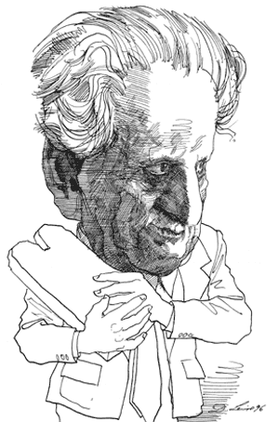
Judaism as the escape from the traps of universalism
Reduction through assimilation → self and other form unity (therefore a totality) (remember Kant?)
Levinas:“Knowledge is re-presentation, a return to presence, and nothing may remain other to it.”
The Other is unknowable because something always move beyond the totalization of knowledge
Heidegger: the particular place and time from which people emerge gives shape to their proper position in history and the Jewish community is without roots
Levinas: celebrates this about the Jewish people
it is this rootlessness which results in the possibility of freeing humankind from the false promises of “family, tribe and nation.”
Judaism, rather than sublimating oneself to the idols of univeralism, demands that they be destroyed.

Slide 9
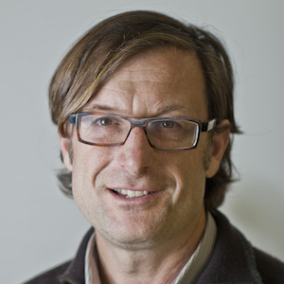
A Levinasian framework for critiquing the law
James Martel (The One and Only Law) traces iconoclasm in the work of Walter Benjamin (the subject a lecture in Gentrain 14)
God’s commandment that “Thou shalt not bow to false idols” negates the possibility of law as a transcendent principle → the law acts as idol
But after the destruction of the law as a totalization, how should we imagine ethical relations?
Without the transcendent principles of the law, how might we ground morality?
Chantal Bax: there do exist ethical bonds between people, but that they “can never take the form of an all-embracing totality”
Levinasian ethics “are precisely defined by their not belonging to a larger unity.”
James Martel

Slide 10
Levinasian ethical relationship
Traditional Enlightenment relation: requires totalization → the assimilation of the other to the self → knowledge is a colonizing and obliterating act
Levinasian ethical relationship: breaks from totality and reaches towards infinity:
“To approach the Other in conversation is to welcome his expression, in which at each instant he overflows the idea a thought would carry away from it. It is therefore to receive from the Other beyond the capacity of the I, which means exactly: to have the idea of infinity. But this also means: to be taught.” (Levinas, Totality and Infinity)
This relationship brings more than the self contains → points to Levinas’s conception of metaphysics: ethics as that which overflows being
moves beyond and past mere ontological categorical boundaries.

Slide 11
Sources & Resources
Bettina Bergo, “Emmanuel Levinas” Stanford Encyclopedia of Philosophy: https://plato.stanford.edu/entries/levinas/#OtheThanBeinBeyoEsse1974TranImma
Emmanuel Levinas, “Ethics as First Philosophy”: https://oldcapitolbooks.files.wordpress.com/2018/09/ethics-as-first-philosophy.pdf
Emmanuel Levinas on Heidegger, “Heidegger, Gagarin and Us”: https://monoskop.org/images/6/68/Levinas_Emmanuel_Difficult_Freedom_Essays_on_Judaism_1997.pdf
Edward Said on Orientalism, a great introduction to Orientalism, useful for understanding the concept of knowledge as a tool of colonization: https://www.youtube.com/watch?v=fVC8EYd_Z_g&t=291s
Lecture by Castleberry, an introduction to Levinas: https://www.youtube.com/watch?v=S-YqKLZDf34

